Slide 1
ROUND TABLE / EUROPE / MESA REDONDA EUROPEA
Current Challenges of European Beekeeping
APIMONDIA CONGRESS, September 6th, 2023
B-THENET:
the Thematic Network
of European Beekeeping
Authors: B-THENET Consortium
Presenter: Dr. Giovanni Formato giovanni.formato@izslt.it
project coordinator

Slide 2
B-THENET Thematic Network
B-THENET is the first Thematic Network in Europe
Focused on Best Beekeeping Practices and Innovations.
It is based on a multi actor approach, engaging: beekeepers, advisors, researchers, policymakers, industry, consumers, and all stakeholders of the beekeeping sector.
Best practices and ready-to-use research innovations are: prioritized and described, using a bottom-up methodology.

Slide 3
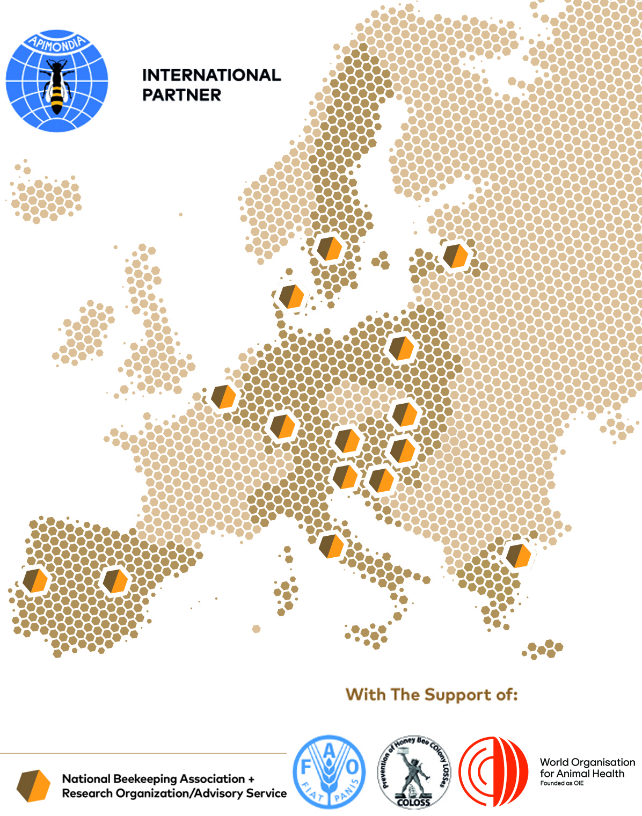
The B-THENET TN Consortium
The B-THENET Consortium
consists of a balanced mix of:
Research organizations
Universities
International and national beekeepers’ associations
Centers for advisors training
Centers for social sciences and humanities
Agencies on communication and dissemination

Slide 4
The B-THENET TN Consortium
1. Beneficiaries
IZSLT (Coordinator; Giovanni Formato)
APRE (Chiara Pocaterra)
APIMONDIA (Jeff Pettis)
LOBA (Alexandre Almeida)
Swedish University of Agricultural Sciences (Lotta Fabricius Kristiansen)
BEELIFE (Noa Simon Delso)
Danish Beekeepers’ Association
(Flemming Vejsnaes)
Slovenian Beekeepers’ Association
(Peter Kozmus)
Complutense University of Madrid
(Aranzazu Meana)
Hellenic Agricultural Organization (Fani Hatjina)
University of Zagreb (Ivana Tlak Gajger)
National Institute of Horticultural Research (Malgorzata Bienkowska)
University of Veterinary Medicine and Pharmacy in Košice (Juraj Toporcak)
Ghent University (Dirk de Graaf)
Hohenheim University (Kirsten Traynor)
Latvia University of Life Sciences and Technologies (Aleksejs Zacepins)
University of Veterinary Medicine of Budapest (Gyula Kasza)
University of Graz (Robert Brodschneider)

Slide 5
The B-THENET TN Consortium
2 Collaborating Partners : Beekeeping associations
- Austria: Biene Österreich;
- Belgium: Vlaams Vulgarisatiecentrum voor Bijenteelt;
- Croatia: Associations of Croatian Beekeeper;
- Germany: Deutscher Imkerbund;
- Greece: Federation of Greek Beekeepers’ Associations;
- Hungary: National Hungarian Beekeeping Association;
- Italy: Associazione Romagnola Apicoltori;
- Latvia: Latvian Beekeepers Association;
- Poland: Krakow Beekeepers Association;
- Portugal: Portoguese Federation of Beekeepers;
- Slovakia: Slovak Association of Beekeepers and Secondary Vocational School Pod Bánošom
- Spain: Asociación de Apicultores de Guadalajara, Aula Apícola Sierra de Hoyo, Asociacion de Veterinarios Especialistas en Sanidady Producion Apicola de España and Fundación Amigos de las Abejas;
- Sweden: Swedish Beekeepers Association and Swedish Professional Beekeepers.

Slide 6
The B-THENET TN Consortium
2. Collaborating Partners: Research institutions
Denmark: University of Aarhus;
Slovakia: Slovak University of Agriculture in Nitra
Slovenia: National Veterinary Institute of Slovenia

Slide 7
The B-THENET TN goals
Identify with a bottom-up approach the most important practices for EU beekeepers
Develop and validate at least 20 Best Beekeeping Practices every year (for a total of at least 80 practices), that are tailored to the local beekeeping conditions, with a multi-actor approach (14 languages, to ease participation of stakeholders)
Disseminate and share knowledge on Best Beekeeping Practices between beekeepers, advisors and stakeholders
Have a more sustainable, resilient and competitive EU Beekeeping Sector

Slide 8
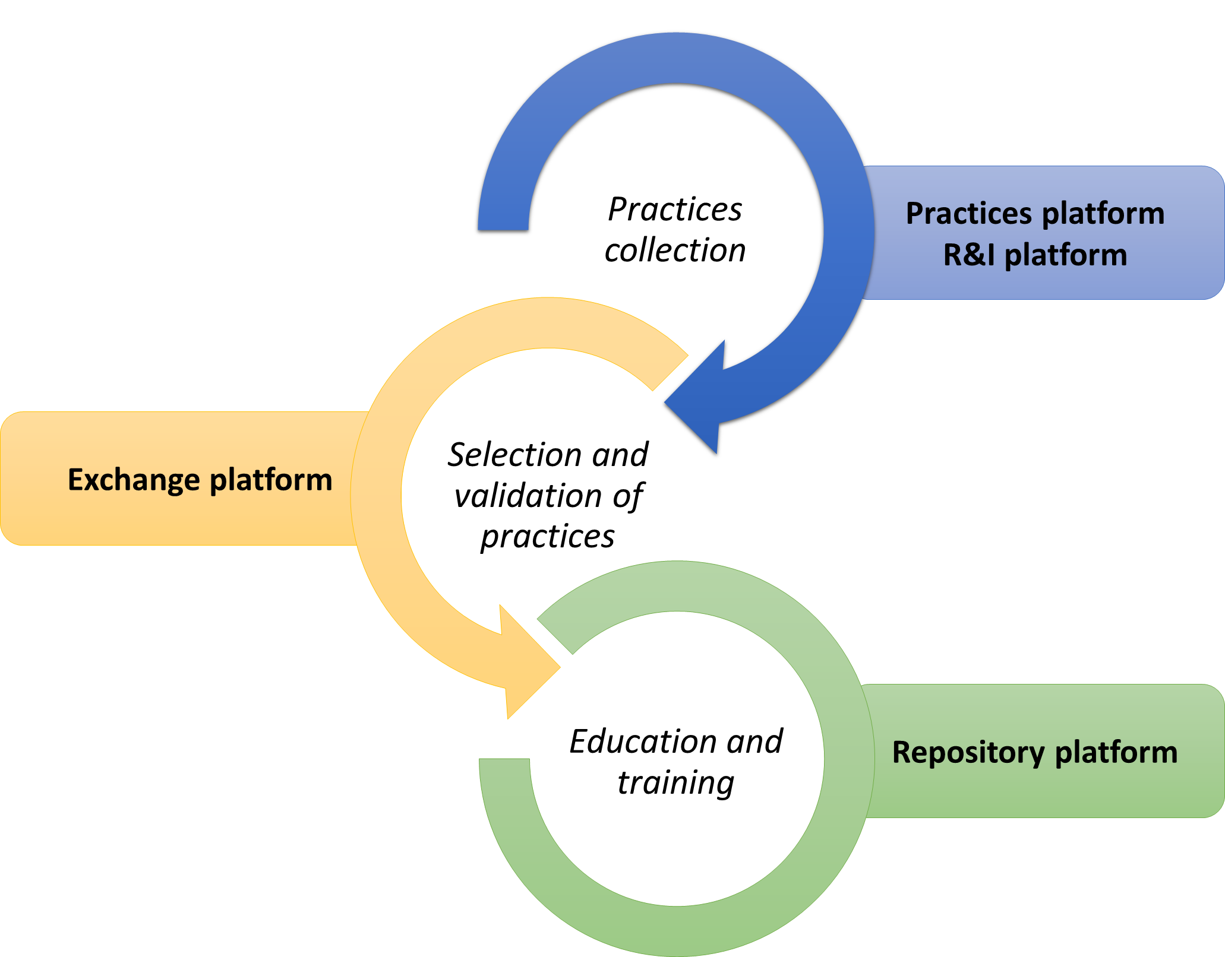
Activities started on
1st Sept. 2022 and will last 4 years
(end: on 31st Aug. 2026)
The B-THENET TN structure
Activities consider the
practices’ collection and prioritization, description and validation, via
3 ONLINE PLATFORMS
Stakeholders are involved in a process of knowledge sharing, education and training on Best Beekeeping Practices.

Slide 9
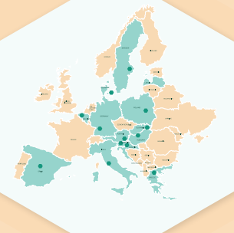
The B-THENET TN activities of knowledge sharing and training on Best Beekeeping Practices
13 NATIONAL B-THENET CENTRES
to knowledge sharing and training among:
beekeepers (2080)/young beekeepers (780),
advisors (520) and all other stakeholders in the EU

Slide 10
3 INTERNATIONAL B-THENET CENTRES
specific for:
Beekeepers,
Advisors and
Other Stakeholders.
Headquarters are based in 4 different countries.

Slide 11
The project website and platform
www.bthenet.eu

Slide 12
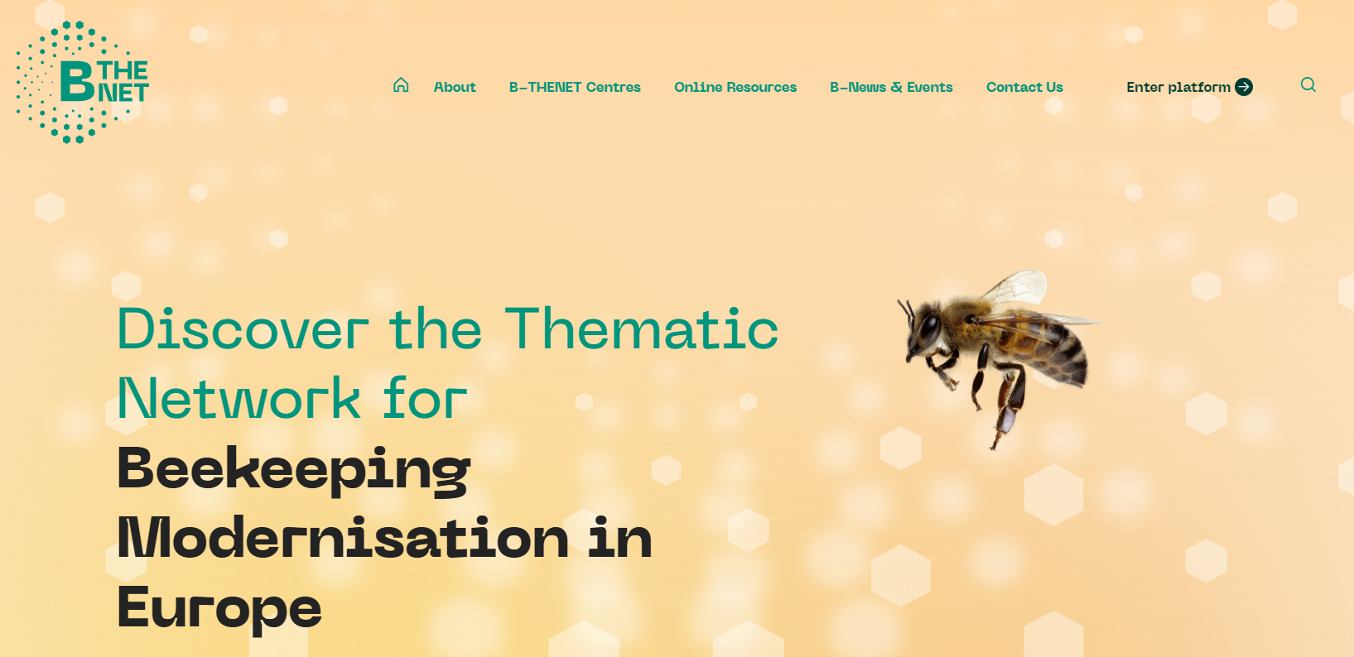
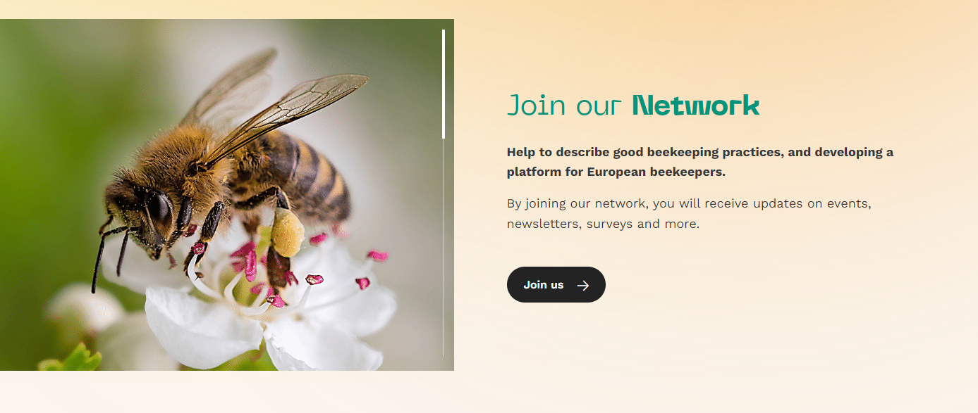
Project website: bthenet.eu
About the project
B-THENET Centers
Online Resources
B-News & Events
Contact Us

Slide 13
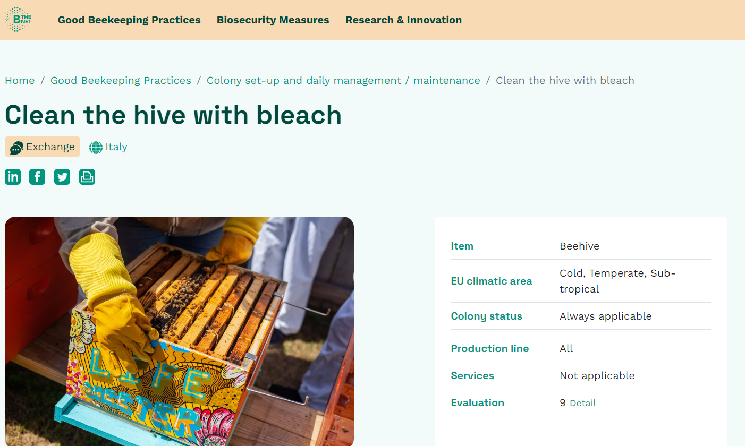
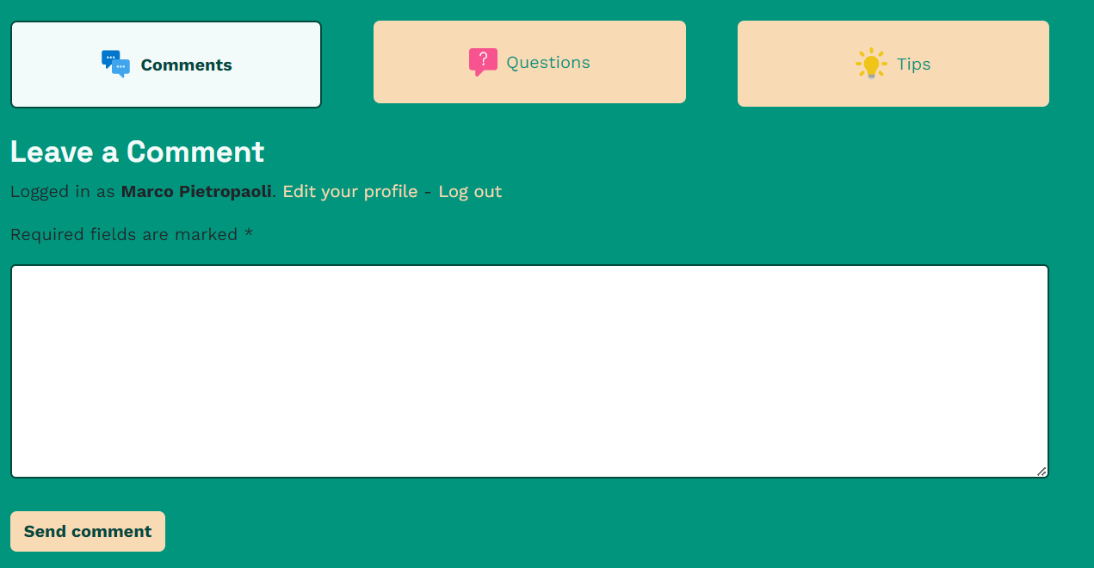
Project platform: bthenet.eu/platform
Online development of practices with descriptions, images, videos, etc…
Registered users can post comments, questions and add tips to improve practices

Slide 14
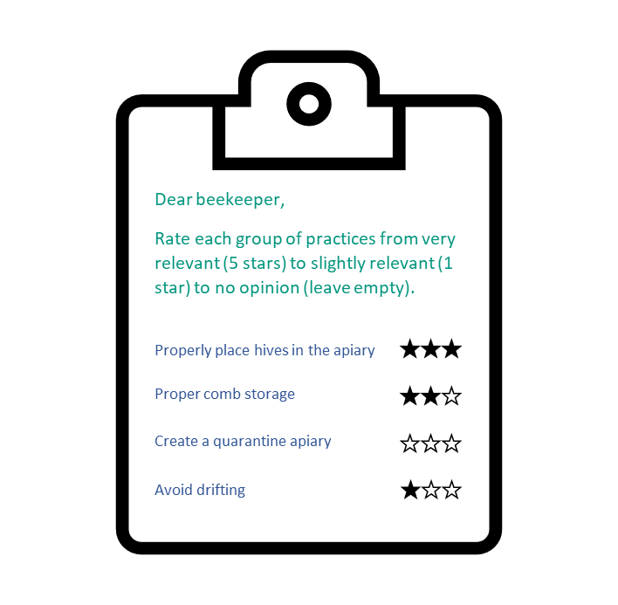
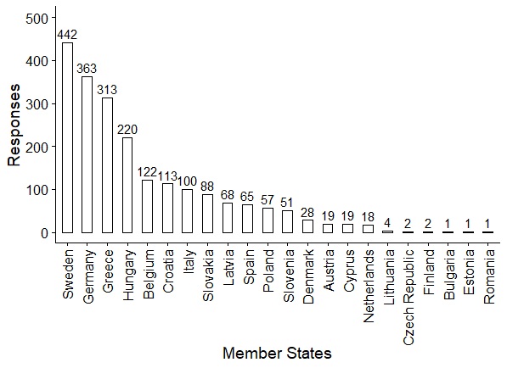
Last updates:
Prioritization of practices:
2,094 answers from 22 EU Member States
EU survey

Slide 15
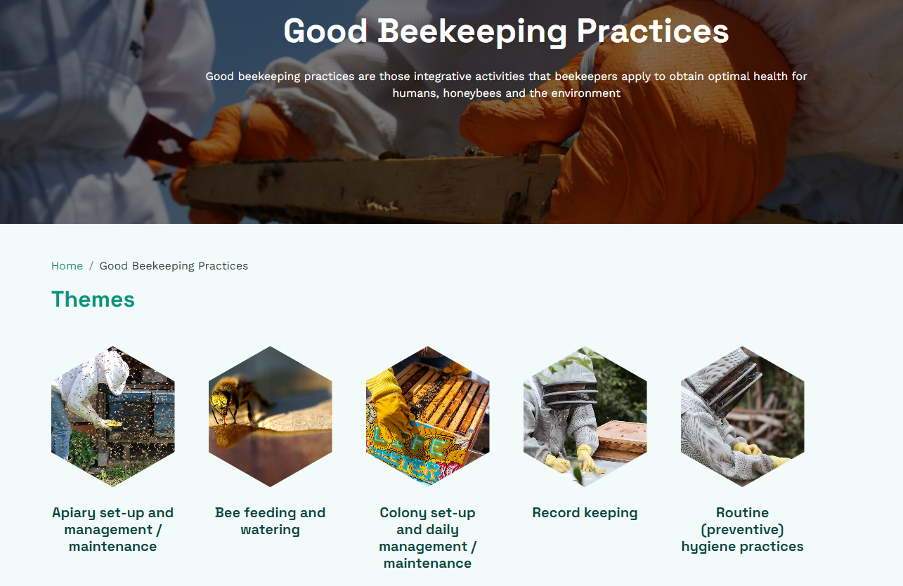
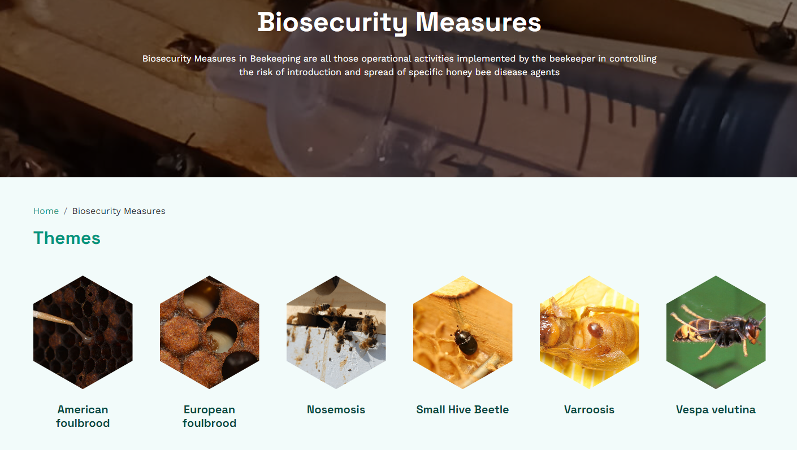
2. Best Beekeeping Practices description on the platform
280 Best Beekeeping Practices (177 Best Beekeeping Practices and 103 Biosecurity Measures) are now described in the platform and available for open discussion!

Slide 16
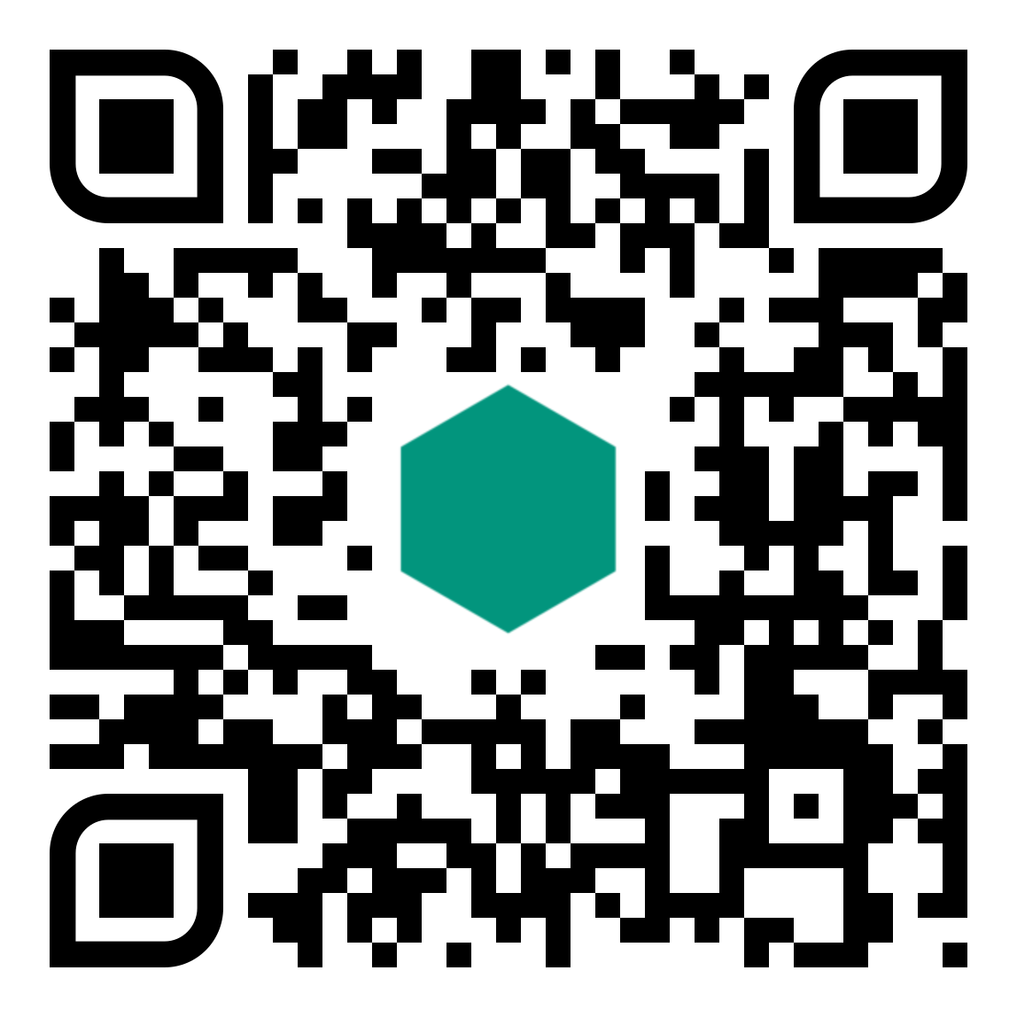
Thank you for your kind attention!
Join the Network!
Dr. Giovanni Formato
giovanni.formato@izslt.it
Register to the platform!

Slide 17
Thank you!
info@bthenet.eu

